Slide 1

COVID-19 Future Forecasting
Date: 28 May 2021
M. NAVYA NIHITHA : 17WH1A0510
J. MRUDULA: 18WH5A0507
K. JAGADISHWARI : 18WH5A0510
Internal Guide: Mr.Shivamurthy Hiremath
Designation: Assistant Professor
Department of Computer Science & Engineering
BVRIT HYDERABAD College of Engineering for Women

Slide 2

COVID-19 Future Forecasting
ABSTRACT:
Machine learning (ML) based forecasting mechanisms have proved their significance to anticipate outcomes to improve the decision making on the future course of actions.
The ML models have been used in many application domains which needed the identification and prioritization of adverse factors for a threat.
Several prediction methods are being popularly used to handle forecasting problems.
This Project demonstrates the capability of ML models to forecast the number of upcoming patients affected by COVID-19 which is presently considered as a potential threat to mankind.
Three types of predictions can be made such as the number of newly infected cases, the number of deaths, and the number of recoveries in the next 10 days. By Using the resultant of the data we are going forecast the COVID-19
BVRIT HYDERABAD College of Engineering for Women

Slide 3
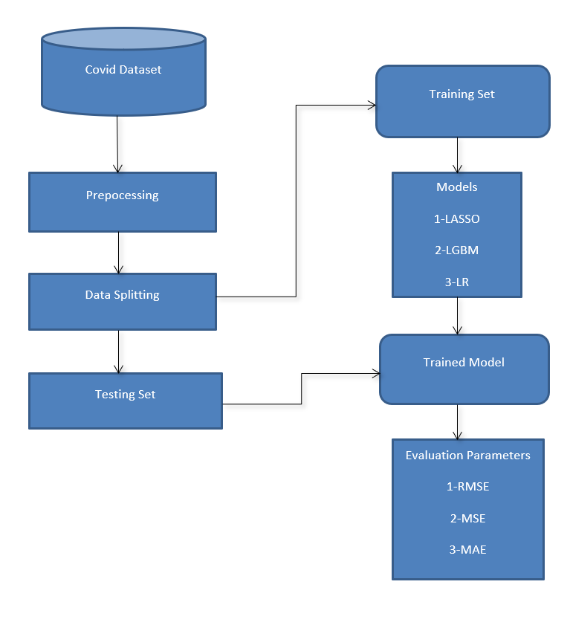
Architecture Diagram
BVRIT HYDERABAD College of Engineering for Women

Slide 4
Technology Stack
Supervised Machine Learning
Python Language
BVRIT HYDERABAD College of Engineering for Women

Slide 5
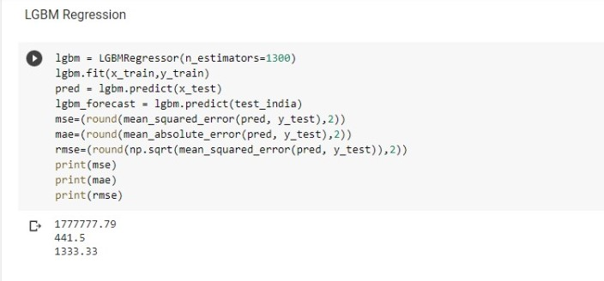
Models
BVRIT HYDERABAD College of Engineering for Women

Slide 6
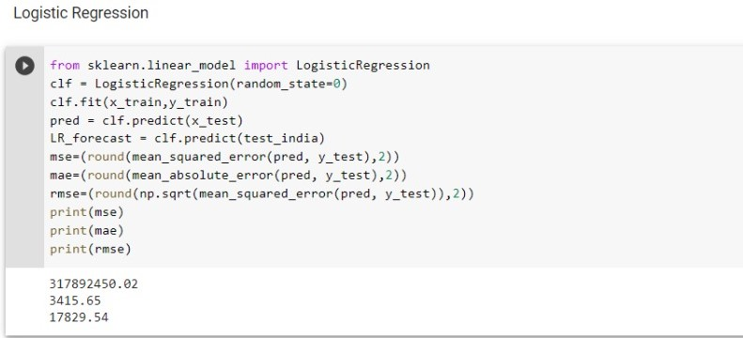
Models
BVRIT HYDERABAD College of Engineering for Women

Slide 7
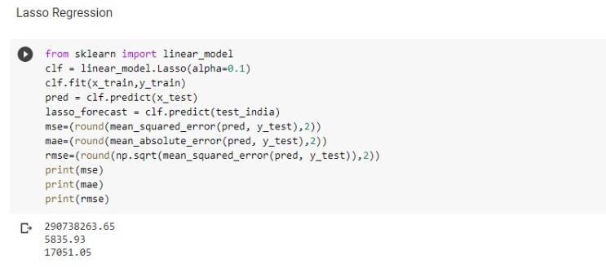
Models
BVRIT HYDERABAD College of Engineering for Women

Slide 8
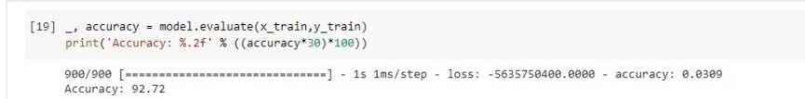
Accuracy
Tensorflow with Multiplex Layer:
BVRIT HYDERABAD College of Engineering for Women

Slide 9
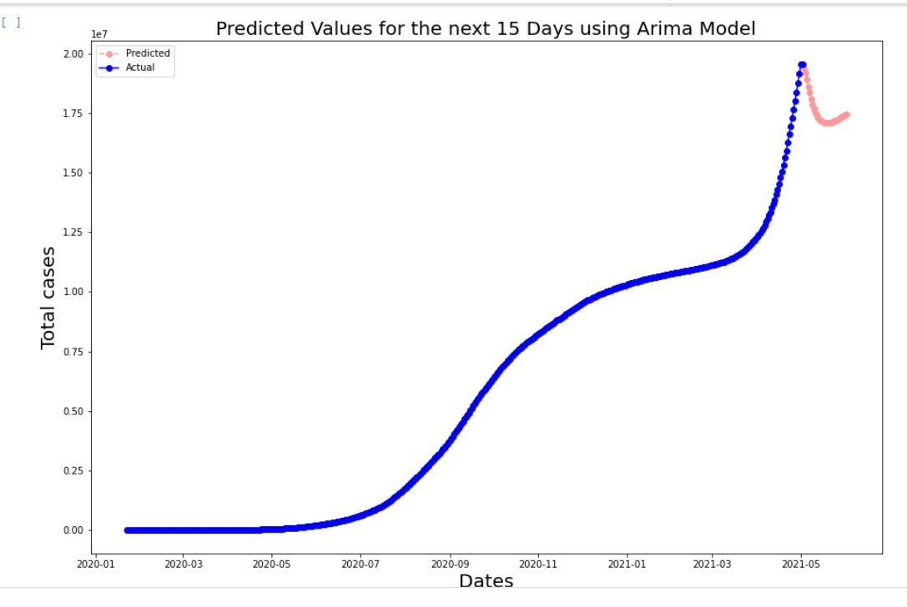
Output
Arima Model:
BVRIT HYDERABAD College of Engineering for Women

Slide 10

REFERENCES
G. Bontempi, S. B. Taieb, and Y.-A. Le Borgne, “Machine learning strategies for time series forecasting,” in European business intelligence summer school. Springer, 2012, pp. 62–77.
2. G. Grasselli, A. Pesenti, and M. Cecconi, “Critical care utilization for thecovid-19 outbreak in lombardy, italy: early experience and forecast during an emergency response,” Jama, 2020.
WHO. Naming the coronavirus disease (covid-19) and the virus that causesit. [Online]. Available: https://www.who.int/emergencies/diseases/novel-coronavirus-2019/technical-guidance/naming-the-coronavirus-disease-(covid-2019)-and-the-virus-that-causes-it
BVRIT HYDERABAD College of Engineering for Women

Slide 11
Thank you
BVRIT HYDERABAD College of Engineering for Women

